Slide 1


CHM 103: Organic Chemistry I
Presented by:
Assoc Prof Okoli BJ MRSC, MACS
Department of Chemical Science,
Faculty of Science & Technology
Bingham University
The University with the difference
Bingham University

Slide 2
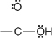
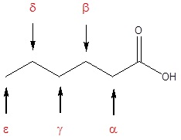
Carboxylic Acids
Carboxylic acids are compounds that contain the carboxyl group:
The carboxyl functional group that characterizes the carboxylic acids is unusual in that it is composed of two functional groups: (1) the carboxyl group and (2) of a hydroxyl group bonded to a carbonyl group. It is often written in condensed form as –CO₂H or –COOH.
Nomenclature of carboxylic acids
The IUPAC system of nomenclature assigns a characteristic suffix to these classes. The –e ending is removed from the name of the parent chain and is replaced -anoic acid. Since a carboxylic acid group must always lie at the end of a carbon chain, it is always is given the #1 location position in numbering and it is not necessary to include it in the name.
Many carboxylic acids are called by the common names. These names were chosen by chemists to usually describe a source of where the compound is found. In common names of aldehydes, carbon atoms near the carboxyl group are often designated by Greek letters. The atom adjacent to the carbonyl function is alpha, the next removed is beta and so on.
atoms.
Bingham University

Slide 3
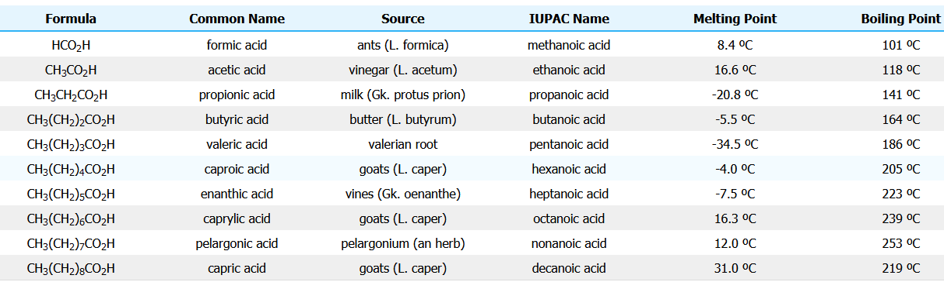
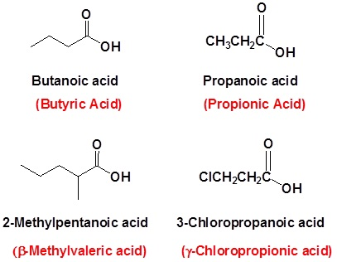
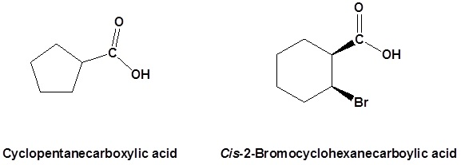
Example (Common Names Are in Red)
Naming carboxyl groups added to a ring
When a carboxyl group is added to a ring the suffix -carboxylic acid is added to the name of the cyclic compound. The ring carbon attached to the carboxyl group is given the #1 location number.
Bingham University

Slide 4
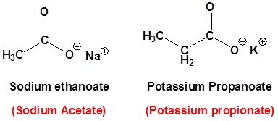
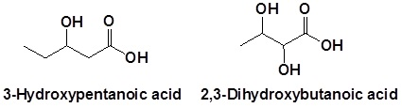
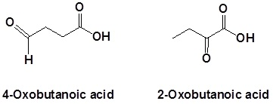
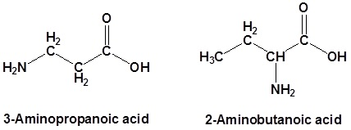
Naming carboxylates
Salts of carboxylic acids are named by writing the name of the cation followed by the name of the acid with the –ic acid ending replaced by an –ate ending. This is true for both the IUPAC and Common nomenclature systems.
Naming carboxylic acids which contain other functional groups
Carboxylic acids are given the highest nomenclature priority by the IUPAC system. This means that the carboxyl group is given the lowest possible location number and the appropriate nomenclature suffix is included. In the case of molecules containing carboxylic acid and alcohol functional groups the OH is named as a hydroxyl substituent. However, the l in hydroxyl is generally removed.
In the case of molecules containing a carboxylic acid and aldehydes and/or ketones functional groups the carbonyl is named as a "Oxo" substituent.
In the case of molecules containing a carboxylic acid an amine functional group the amine is named as an "amino" substituent.
Bingham University

Slide 5
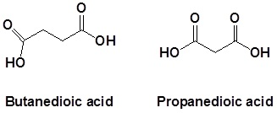
When carboxylic acids are included with an alkene the following order is followed:
(Location number of the alkene)-(Prefix name for the longest carbon chain minus the -ane ending)-(an –enoic acid ending to indicate the presence of an alkene and carboxylic acid)
Naming dicarboxylic acids
For dicarboxylic acids the location numbers for both carboxyl groups are omitted because both functional groups are expected to occupy the ends of the parent chain. The ending –dioic acid is added to the end of the parent chain.
Physical properties of carboxylic acids
The physical properties (for example, boiling point and solubility) of the carboxylic acids are governed by their ability to form hydrogen bonds.
Boiling points
Before we look at carboxylic acids, a reminder about alcohols: The boiling points of alcohols are higher than those of alkanes of similar size because the alcohols can form hydrogen bonds with each other as well as van der Waals dispersion forces and dipole-dipole interactions. The boiling points of carboxylic acids of similar size are higher still. For example:
Bingham University

Slide 6
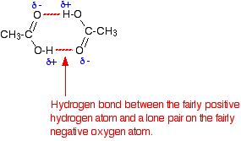
These are chosen for comparison because they have identical relative molecular masses and almost the same number of electrons (which affects van der Waals dispersion forces). The higher boiling points of the carboxylic acids are still caused by hydrogen bonding, but operating in a different way. In a pure carboxylic acid, hydrogen bonding can occur between two molecules of acid to produce a dimer.
This immediately doubles the size of the molecule and so increases the van der Waals dispersion forces between one of these dimers and its neighbors - resulting in a high boiling point.
Solubility in water
In the presence of water, the carboxylic acids do not dimerize. Instead, hydrogen bonds are formed between water molecules and individual molecules of acid. The carboxylic acids with up to four carbon atoms will mix with water in any proportion. When you mix the two together, the energy released when the new hydrogen bonds form is much the same as is needed to break the hydrogen bonds in the pure liquids.
The solubility of the bigger acids decreases very rapidly with size. This is because the longer hydrocarbon "tails" of the molecules get between water molecules and break hydrogen bonds. In this case, these broken hydrogen bonds are only replaced by much weaker van der Waals dispersion forces. The energetics of dissolving carboxylic acids in water is made more complicated because some of the acid molecules actually react with the water rather than just dissolving in it.
Bingham University

Slide 7
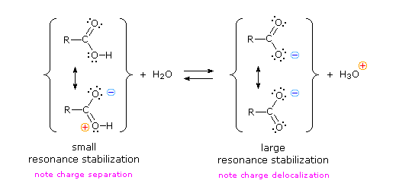
Acidity of Carboxylic Acids
Carboxylic acids show K_{a} values in the order of 10 ⁻⁴ to 10 ⁻⁵ and thus readily react with ordinary aqueous bases such as sodium hydroxide and sodium bicarbonate. This acidity is due to two factors.
First, the oxygen atom of the carboxyl group bonded to the hydrogen atom has a partial positive charge on it because of resonance.
Second, the anion that results from the removal of the hydrogen attached to the carboxyl oxygen is resonance stabilized.
PREPARATION OF CARBOXYLIC ACIDS
Carboxylic acids are mainly prepared by the oxidation of a number of different functional groups, as the following sections detail.
Oxidation of alkenes
Oxidation of alkenes
Oxidation of primary alcohols and aldehydes
Oxidation of alkyl benzenes
Hydrolysis of nitriles
Carbonation of Grignard reagents
Bingham University

Slide 8
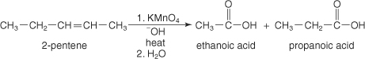
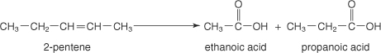
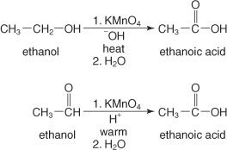
1. Oxidation of alkenes
Alkenes are oxidized to acids by heating them with solutions of potassium permanganate (KMnO₄) or potassium dichromate (K₂Cr₂O₇).
2. Oxidation of alkenes
The ozonolysis of alkenes produces aldehydes that can easily be further oxidized to acids.
3. The oxidation of primary alcohols and aldehydes
The oxidation of primary alcohols leads to the formation of aldehydes that undergo further oxidation to yield acids. All strong oxidizing agents (potassium permanganate, potassium dichromate, and chromium trioxide) can easily oxidize the aldehydes that are formed.
Bingham University

Slide 9
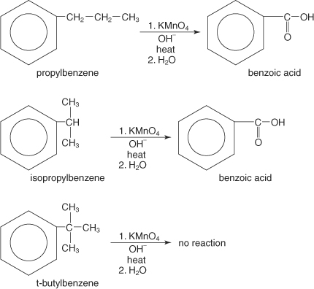
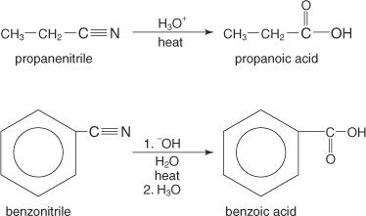
4. The oxidation of alkyl benzenes
Alkyl groups that contain benzylic hydrogens—hydrogen(s) on a carbon α to a benzene ring—undergo oxidation to acids with strong oxidizing agents.
In the above example, t‐butylbenzene does not contain a benzylic hydrogen and therefore doesn't undergo oxidation.
5. Hydrolysis of nitriles
The hydrolysis of nitriles, which are organic molecules containing a cyano group, leads to carboxylic acid formation. These hydrolysis reactions can take place in either acidic or basic solutions.
Bingham University

Slide 10
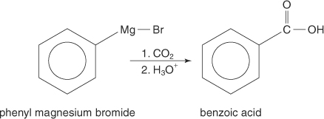
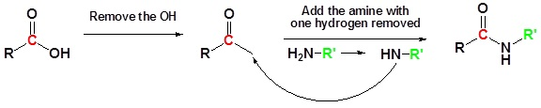
6. The carbonation of Grignard reagents
Grignard reagents react with carbon dioxide to yield acid salts, which, upon acidification, produce carboxylic acids.
REACTIONS OF CARBOXYLIC ACIDS
Carboxylic acids undergo reactions to produce derivatives of the acid. The most common derivatives formed are esters, acid halides, acid anhydrides, and amides.
1. Conversion of a Carboxylic Acid to an Amide
The direct reaction of a carboxylic acid with an amine would be expected to be difficult because the basic amine would deprotonate the carboxylic acid to form a highly unreactive carboxylate. However when the ammonium carboxylate salt is heated to a temperature above 100 ºC water is driven off and an amide is formed.
Bingham University

Slide 11
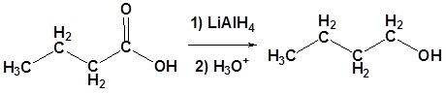
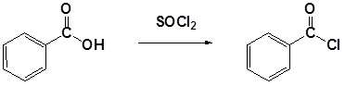
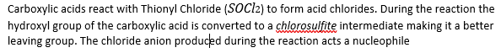
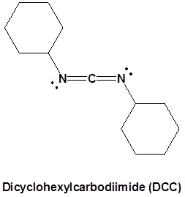
2.Conversion of carboxylic acids to alcohols using LiAlH4
Carboxylic acids can be converted to 1º alcohols using Lithium aluminum hydride (LiAlH₄). Note that NaBH₄ is not strong enough to convert carboxylic acids or esters to alcohols. An aldehyde is produced as an intermediate during this reaction, but it cannot be isolated because it is more reactive than the original carboxylic acid.
3. Conversion of carboxylic acids to acid chlorides
4. Conversion of Carboxylic acids to amides using DCC as an activating agent
The direct conversion of a carboxylic acid to an amide is difficult because amines are basic and tend to convert carboxylic acids to their highly unreactive carboxylates. In this reaction the carboxylic acid adds to the DCC molecule to form a good leaving group which can then be displaced by an amine during nucleophilic substitution. DCC induced coupling to form an amide linkage is an important reaction in the synthesis of peptides.
Bingham University

Slide 12
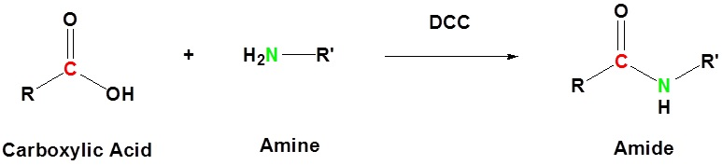
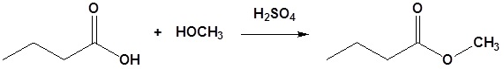
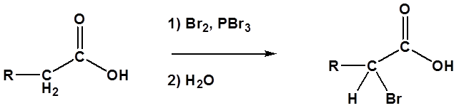
5.Fischer Esterification
Fischer esterification is the esterification of a Carboxylic acid by heating it with an alcohol in the presence of a strong acid as the catalyst.
6. Hell-Volhard-Zelinskii Reaction
Although the alpha bromination of some carbonyl compounds, such as aldehydes and ketones, can be accomplished with Br₂ under acidic conditions, the reaction will generally not occur with acids, esters, and amides. This is because only aldehydes and ketones enolize to a sufficient extent to allow the reaction to occur. However, carboxylic acids, can be brominated in the alpha position with a mixture of Br₂ and PBr₃ in a reaction called the Hell-Volhard-Zelinskii reaction.

Slide 13
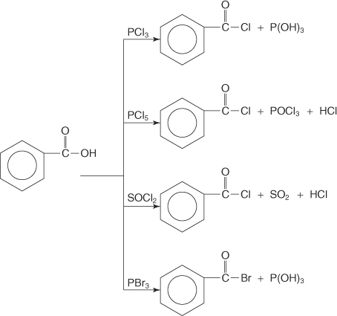
7 Acid halide formation
Carboxylic acids react with phosphorous trichloride (PCl₃), phosphorous pentachloride (PCl₅), thionyl chloride (SOCl₂), and phosphorous tribromide (PBr₃) to form acyl halides.
Bingham University

Slide 14
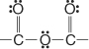
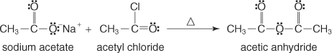
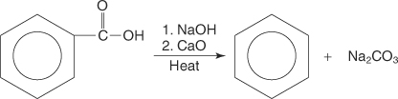
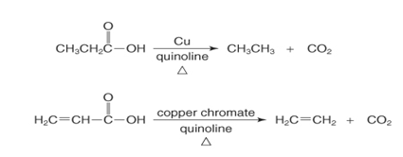
8 Acid anhydride formation
Following is the anhydride group:
This group forms by reacting the salt of a carboxylic acid with an acyl halide.
9 Decarboxylation reaction
i.Decarboxylation is the loss of the acid functional group as carbon dioxide from a carboxylic acid. The reaction product is usually a halo-compound or an aliphatic or aromatic hydrocarbon.
The following illustration shows the sodalime method:
Alipathic and aromatic acids can be decarboxylated using simple copper salts.
Bingham University

Slide 15
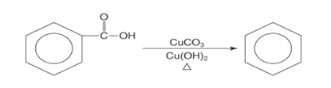
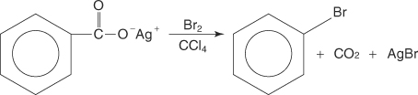
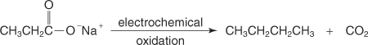
ii. Hunsdiecker reaction
In a Hunsdiecker reaction, the silver salt of an aromatic carboxylic acid is converted by bromine treatment to an acyl halide.
iii. Kolbe electrolysis
In Kolbe electrolysis, electrochemical oxidation occurs in aqueous sodium hydroxide solution, leading to the formation of a hydrocarbon.
Bingham University

Slide 16

Bingham University

Slide 17

Bingham University

Slide 18
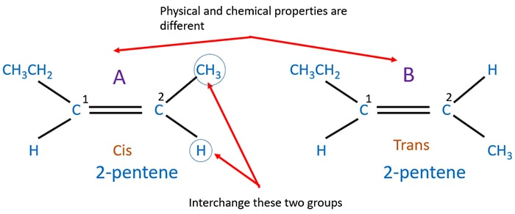
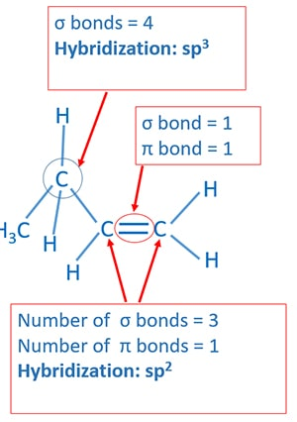
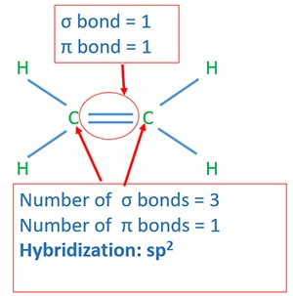
Geometrical isomerism of 2-butene
E.G of geometrical isomerism in 2-pentene.
Hybridization of ethene
When consider one carbon atom, it has three σ bonds and one Π bond. Therefore hybridization of that carbon atom is sp².
Hybridization of propene
Bingham University

Slide 19
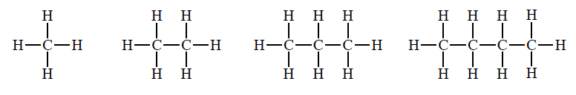

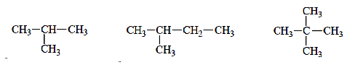
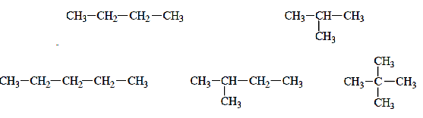
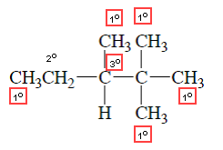
II. Unbranched & branched chain alkanes
Unbranched/Straight chain alkanes
Alkanes can either be Unbranched or branched
This is an example of a family of compounds known as homologous series (each member differs from the next by the addition of one methylene group (CH2).
Branched chain alkanes
Quickly class can you draw the structures of the first 12 unbranched alkane?
III. constitutional isomers
As the number of carbons of an alkane increase beyond three, the number of
possible structures increases. e.g. C4H10 and C5H12
These are e,g of constitutional isomers: Compounds that have the same
molecular formula but different connectivity.
Example
Carbons in alkanes or other organic compounds can be classified as primary (1°),
secondary (2°), tertiary (3°), and quaternary:
Bingham University

Slide 20



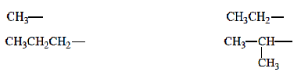

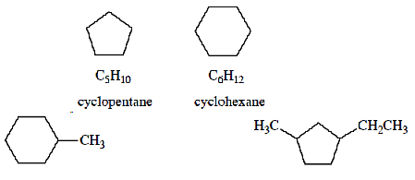
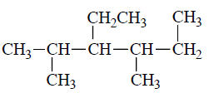
IV. Alkyl Groups
Removing a H from an alkane gives an alkyl group or alkyl substituent. Alkyl
groups are named by changing the –ane ending of an alkane with –yl.
V. Systematic (IUPAC) Nomenclature of Alkanes
The systematic name of an alkane is obtained using the following rules:
The unbranched alkanes are
named according to the # carbon atoms
2. For alkanes containing branched carbon chains, find the longest continuous chain (if two or more chains within a structure have the same length, choose the one with
the greatest # branches). This is your parent chain.
3. Number the carbons of the parent chain from one end to the other in the direction
that gives the first branch the lower #.
4. Name each branch (substituent) and identify the carbon # of the parent chain at
which it occurs. If two substituents are on the same carbon atom, use that number
twice. When two or more substituents are identical, use a prefix di-, tri-, tetra, etc.
to indicate how many. Alkyl substituents are named by changing the ane ending to
yl.
5. Construct the name by writing substituents first, followed by the name of the alkane
corresponding to the parent chain. The substituent groups are listed in alphabetical
order (the numerical prefixes di-, tri-, etc. as well as the prefixes tert- and sec- are
ignored in alphabetizing, but the prefixes iso, neo, and cyclo are considered in
alphabetizing substituent groups).
VI. Nomenclature of Cycloalkanes
Add prefix "cyclo" to alkane name
Example
Examples
Bingham University

Slide 21
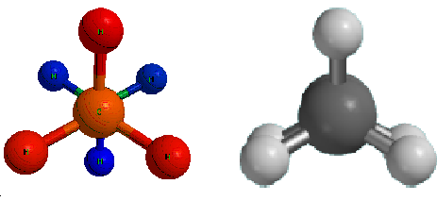


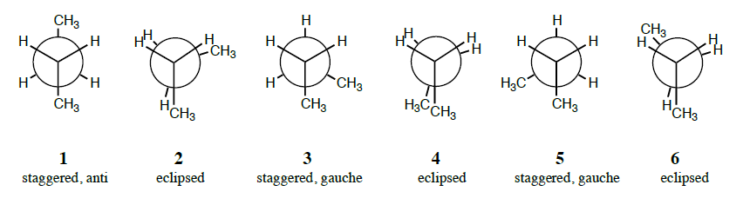
VII. Physical Properties of Alkanes
VIII. Conformations of Alkanes
The two methyl groups are not fixed in a single position but are free to rotate about the σ -bond connecting the two carbons. The different spatial arrangements of the atoms that result from rotation about a single bond are called conformations.
Alkanes contain only nonpolar C−H and C−C bonds, and as a result they exhibit only weak van Der Waals forces.
Alkanes have low bp’s and mp’s compared to more polar compounds of comparable size.
Bp and mp increases as the number of carbons increases because of increased urface area.
Bp decreases with increased branching because of decreased surface area.
Mp increases with increased symmetry.
A. Conformations of Ethane
Staggered
Eclipsed
B. Conformations of Butane & higher MW alkanes
Q: Why is the eclipsed conformation higher in energy?
A: Electron-electron repulsion between the bonds in the eclipsed conformation increases its energy. This is called
torsional strain.
1. Rotation about the C–1—C–2 bond:
• All staggered conformations are equal in energy.
Rotation about the C–2—C–3 bond:
All staggered conformations are not equal in energy
• A staggered conformation with two larger groups 180° from each other is called anti.
• A staggered conformation with two larger groups 60° from each other is called gauche.
Bingham University

Slide 22


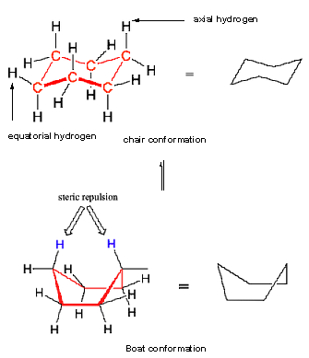

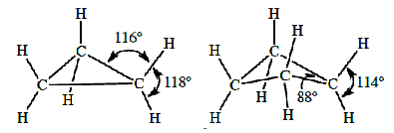
IX. Conformations of Cycloalkanes
Three factors contribute to ring strain:
1. angle strain: When the angles between carbon-carbon bonds are constrained by the size of the ring to be much smaller than the ideal tetrahedral angle of 109.5°, there will be significant angle strain.
2. eclipsed interactions (AKA: torsional strain): When the hydrogens are eclipsed due to the constraints of the ring, this contributes to ring strain. The larger the number of eclipsed interactions, the larger the ring strain.
3. steric strain: caused by atoms or groups of atoms approaching each other too closely
The conformation of cylcoalkanes are determined by ring strains
Q. How do we determine ring strain?
A. By comparing heats of combustion of cycloalkanes with unbranched alkanes.
X. Conformations of Cycloalkanes
A. Cyclopropane
Because the three carbons define a plane, cyclopropane is planar and has severe angle strain and torsional strain.
B. Cyclobutane
Cyclobutane suffers from severe angle strain.
Cyclobutane also suffers from van der Waals repulsions due to the eclipsed H’s.
C. Cyclohexane
It has a chair and boat conformations which are of different energies.
The most stable conformation of cyclohexane is the chair conformation.
Note: As a general rule, the most stable chair conformation of a six-membered ring will be that in which the bulkiest groups are in the equatorial position.
Exercise : Draw the lower energy chair conformations of
trans-1,2-dimethylcyclohexane, and
b) trans-1-isopropyl-3-methylcyclohexane.
Bingham University

Slide 23


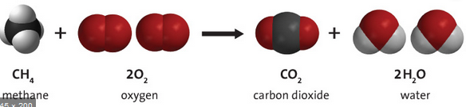
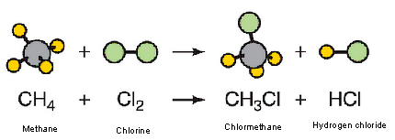

Lets talk properties of the alkanes
Secondly, lets talk about the reactions of the alkanes
Reaction 1: Combustion
Alkanes are :
extremely unreactive,
stable,
low energy species derived from petroleum & petroleum by-products.
Petroleum: complex mixture of alkanes, cycloalkanes, and
aromatic hydrocarbons formed by the decomposition of plant & animal material under the earth’s crust.
Reaction 2: Halogenation
Note: Both of these reactions are oxidation/reduction reactions.
For organic compounds, oxidation-reduction reactions result in a CHANGE IN ELECTRON DENSITY around the carbon atom rather than a complete transfer of electrons.
Question 1. Identify the reducing and oxidising agents in both reaction above
Question 2. Write a similar reaction for :
(a). 2 2 4-trimethylhexane
(b). Cis-1,4-dimethylcyclohexane
Bingham University

Slide 24
I. Oxidative addition
Bingham University

Slide 25
2. Reductive elimination: involves the elimination or expulsion of a molecule from a transition metal complex. In the process of this elimination, the metal centre is reduced by two electrons. The groups being eliminated must be in a mutually cis orientation.
3. Migratory insertion:A migratory insertion reaction is when a cisoidal anionic and neutral ligand on a metal complex couple together to generate a new coordinated anionic ligand. This new anionic ligand is composed of the original neutral and anionic ligands now bonded to one another.
Bingham University

Slide 26

3. Migratory insertion:
No change in formal oxidation state (exception: alkylidenes).
The two groups that react must be cisoidal to one another.
A vacant coordination site is generated by the migratory insertion.
Migratory insertions are favoured on more electron-deficient metal centres.
(a). Alkene Migratory Insertions: is the basis for almost all transition metal-based polymerization catalysts. A polymerization is just many, many migratory insertions of an alkene and alkyl (the growing polymer chain) interspaced with alkene ligand addition reactions.
Bingham University

Slide 27


Alkene Migratory Insertions:
An alkene and a hydride usually react via a migration of the hydride to the coordinated alkene ligand:
Bingham University

Slide 28
Alkene Migratory Insertions:
The backwards reaction, of course, is a β-hydride elimination and is usually quite favorable if there is an empty orbital cis to the alkyl ligand. Thus, the general importance of having a trapping ligand to coordinate to the empty orbital generated from the migratory insertion.
Bingham University

Slide 29
4. β -Hydride elimination: Elimination reactions are just the reverse of migratory insertion
reactions. β−Hydride elimination is a reaction in which an alkyl group bonded to a metal centre is converted into the corresponding metal-bonded hydride and an alkene. The key points to remember are:
i. No change in formal oxidation state (exception: alkylidenes).
ii. A vacant orbital is cisoidal to the group to do an elimination reaction on. Alternatively, a cisoidal labile ligand that can easily dissociate to open up an empty orbital.
Bingham University

Slide 30
5. Olefin metathesis: involves two olefin substrates which form a four-membered ring intermediate and then rearrange the substituents to form two new carbon-carbon double bonds. Late transition metal alkylidene compounds greatly broaden the methodology to form carbon-carbon double bonds with high functional group tolerance.
6. Transmetalation :is a type of organometallic reaction that involves the transfer of
ligands from one metal to another. It has the general form:
M₁–R + M₂–R′ → M₁–R′ + M₂–R
where R and R′ can be, but are not limited to, an alkyl, aryl, alkynyl, allyl, halogen, or
pseudo-halogen group. The reaction is usually an irreversible process due to thermodynamic and kinetic reasons.
Bingham University

Slide 31

6. Transmetalation
Thermodynamics will favor the reaction based on the electronegativities of the metals and kinetics will favor the reaction if there are empty orbitals on both metals. During transmetalation the metal-carbon bond is activated, leading to the formation of new metal-carbon bonds. Transmetalation is commonly used in catalysis, synthesis of main group complexes, and synthesis of transition metal complexes. There are different types of transmetalation including
Bingham University

Slide 32

Bingham University

Slide 33

Bingham University

Slide 34




Bingham University

Slide 35

Bingham University

Slide 36

Bingham University

